Slide 1
Young children’s causal and counterfactual judgments
Teresa McCormack
Steven Butterfill
Christoph Hoerl
Patrick Burns
AHRC Causal Understanding Project
Acknowledgements:
Helena McCormack
Olive Taylor
Michelle Rankin
Notes:
Opportunity to talk about some work in progress – I’m going to present preliminary work on a series of experiments, some involving children making causal judgments and some in which children make counterfactual judgments.

Slide 2
Causal and counterfactual judgments
Processing view: Certain causal judgments derive from/depend upon a consideration of counterfactual alternatives.
Psychological relatedness view: The representations that support certain causal judgments might be expected to support corresponding counterfactual judgments.
Notes:
Begin by distinguishing between two general sorts of claims that might be made about causal and counterfactual judgments. It could be that in some circumstances/tasks, people use counterfactual reasoning to arrive at a causal conclusion. What I am going to describe shortly is one version of such a claim that has been made about a specific type of causal judgments.
Alternatively, a weaker claim that might be made is that we predict consistency between the two judgments types because similar representations support both. I take it that the Bayes Nets approach described by David is a type of account that might make such a claim. It is in the spirit of interventionist approach, although Jim has said in his writings that it would be possible to have an interventionist conception of causation without being able to make explicit counterfactual judgments. Nevertheless, it may be that in a population which can make such judgments (e.g., adults) you may generally expect some degree of consistency.
The issues are particularly interesting developmentally. For example, if you found developmental differences in patterns of causal judgements, it may be that a processing account could explain such differences as due to differences in ability to make counterfactual judgments. Furthermore, we might ask whether counterfactual and causal judgements are consistent in children, or whether there are developmental changes in the relationship between the two types of judgments. For example, it may be that young children can make accurate causal judgements but can’t make corresponding counterfactual judgment, and that is itself may suggest something interesting about the nature of their causal understanding.

Slide 3
Processing claims in the traditional causal learning literature?
Lovibond and colleagues: inferential reasoning processes and blocking in human causal learning.
Counterfactual reasoning explains patterns found in blocking tasks.
Part of larger claim about the role of explicit inferential reasoning processes in causal learning.
Notes:
I want to turn now to considering a specific processing claim that has been made in the causal learning literature. In their recent account of what are called blocking phenomena, Lovibond and others have suggested that patterns of performance on blocking tasks that are difficult to explain in terms of more traditional associative accounts should in fact be explained by assuming that subjects are using a chain of inferential reasoning that involves a consideration of counterfactuals. In fact, they have a larger theoretical agenda which is to argue against existing associative or mathematical accounts of causal learning, and to argue that in fact humans at least are using a more explicit and effortful type of reasoning in such tasks. Not going to expand on that claim here, focus on their specific claim about blocking.

Slide 4
Blocking
Forwards
A+ AB+ B?
--- CD+ C?
Backwards
AB+ A+ B?
CD+ --- C?
Notes:
What is blocking? Imagine your task is to diagnose which foods cause an allergic reaction. You find out that if Food A is eaten on its own it does so. Now Food A and Food B are eaten together, and again the reaction occurs. Since the reaction is already predicted by the presence of Food A, typically subjects tend to assume that B is not a cause of the allergic reaction – previous pairing of Food A and outcome has blocked learning about B. This is usually shown by demonstrating different ratings of causal strength to Food B in a situation in which the food it is paired with has already been shown to be causally efficacious that to a food C in which neither food in the pair had previously been shown to cause or not cause the reaction.
Note that studies with humans have shown that such blocking can occur either prospectively (the A-allergic reaction is shown first) or retrospectively (it is shown after the paired demonstration). Backwards blocking has been argued to be of great theoretical significance, becaused it caused a problem for early associative models of such learning. Such models assumed that what drives learning is whether or not an outcome is unexpected. In forwards case, it is the fact that the allergy is already predicted that blocks learning of B; in the backwards case, you might expect no new learning to occur about B to occur when A is singly presented as the allergic reaction is already predicted by A. However, it turns out that relative to the appropriate control, the causal status of B is retrospectively re-adjusted. Traditional associative models have had to be adjusted to allow for backwards blocking; major debate still over how to explain this phenomenon.

Slide 5
Counterfactuals and Blocking
When causal effects are additive (F+, G+, FG++)
AB+ A+
“A is causal. If B were causal, the outcome would have been ++. It was not. Therefore B is not causal.”
When causal effects are not additive (F+, G+, FG+)
AB+ A+
“A is causal. If B were not present, the outcome would have happened anyway. Therefore no information about B’s status (baseline).”
Notes:
In the literature, it has been argued that human subjects follow a chain of counterfactual reasoning in such circumstances. We can distinguish here between cases in which causal effects are additive and those in which they are not. Imagine an experiment in which you have previously learned that the presence of two causal agents gives a larger reaction than one (so if F and G both cause the reaction, if the two are eaten together a larger reaction occurs). Now imagine BB condition in which you see that A and B paired together results in a reaction, and then see A causes the same level of reaction on its own. Here is the chain of counterfactual reasoning that is supposed to occur:
A different chain of reasoning is assumed to occur when the experimental set-up is such that the causal effect is not additive. Here the prediction is that participants will conclude they have learned nothing about B’s causal status from the previous AB presentations that yielded a reaction, since the reaction would have occurred anyway without B’s presence. Under these circumstances, judgements about B’s causal status are assumed to drop to a baseline (i.e., how likely any food at all is lead to a reaction, about which no information has been given).
So we have an example here of a processing account of a phenomenon in causal reasoning tasks – backwards blocking. We now turn to consider potential developmental implications of such an account.

Slide 6
Children and Blocking
Processing account
Ability to make appropriate counterfactual judgments necessary.
Would we predict developmental changes?
Psychological relatedness account
Consistency between children’s causal and counterfactual judgments in blocking task.
A/B is causal/not causal = if B/A had not been present, the effect would/would not have occurred.
Notes:
On this account, the ability to make counterfactual judgements might be viewed as necessary for the backwards blocking phenomenon to be observed, at least in certain tasks. We might potentially either predict or explain developmental changes by making an appeal to developmental changes in the ability to make such counterfactual judgments.
We could of course also explore a weaker claim: that we would expect consistency in children’s judgements across blocking tasks in which they are asked to make either causal or counterfactual judgments.

Slide 7
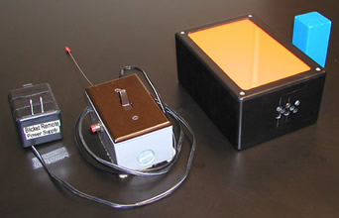
The “Blicket Detector”

Slide 8
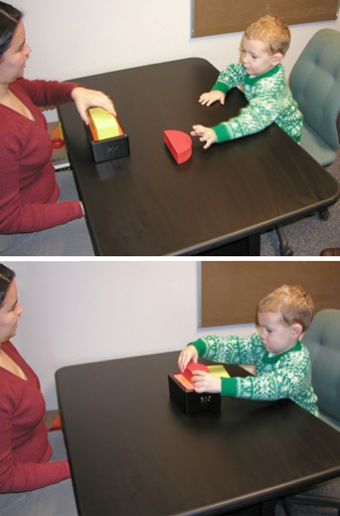
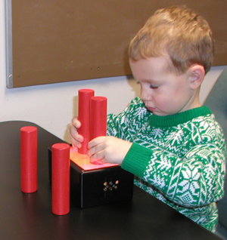

Slide 9
Sobel et al. (2004)
Demo | 1 | 2 | 3 | Response
Trial Type
Backwards blocking | AB√ | AB√ | A√ | B = NO
Retrospective generative | AB√ | AB√ | Ax | B = YES
Association | A√ | B√ | B√ | A = YES B = YES
Notes:
The backwards blocking phenomenon explored by David and colleagues in 2004. Number of demonstrations very small in comparison to adult causal learning tasks, as is no of trials (this is to some extent inevitable).

Slide 10
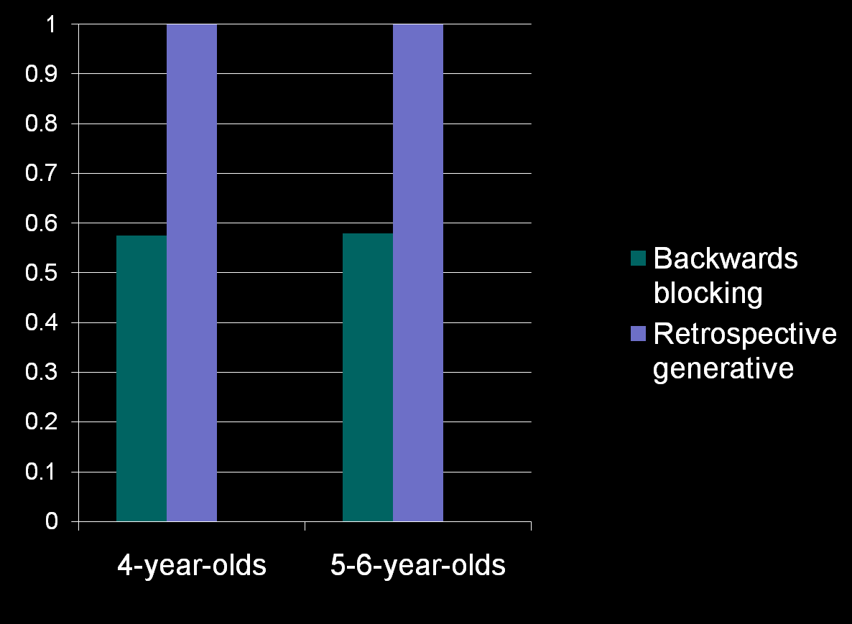
Our data: Responses to B (paired item)
Notes:
Children are asked to make causal judgements for both A and B items; here we report only responses to B items (paired ones never seen on their own). Children only give yes/no responses rather than causal strength judgemnts. We have replicated David’s experimental pretty closely, and found results similar to his: significant differences between BB and RG trials in both age-groups, although levels of responses to B in the BB condition are somewhat higher than he found. In the pretraining part of the task, half of the items children see set off the detector. Thus, there is a base-rate in this task of about 50%. You can see that children’s responses to B are similar to this base-rate.

Slide 11
Some considerations
Not additive; on counterfactual analysis responses to B are predicted just to be baseline.
Comparison is not with the normal control (CD+).
One possibility: children treating task as forced choice.
Original task: always asked about A first.
Notes:
However, it is important to note that in this task, the normal control has not been used. I’ll return to this in a second, but need to clear up one issue first – is it the case that children simply give the opposite response to B as they have given to A – on any trial asked about both. If say yes to A, say no to B? Following Sobel et al., we always asked about A first – what happens if you do it other way round?

Slide 12
Sobel et al. (2004)
Demo | 1 | 2 | 3 | Response
Trial Type
Backwards blocking | AB√ | AB√ | A√ | B = NO
Retrospective generative | AB√ | AB√ | Ax | B = YES
Association | A√ | B√ | B√ | A = YES B = YES

Slide 13

Asking about B (paired item) first
Notes:
Here are data from the 4-year-olds; results are identical.

Slide 14
Choosing a control
Sobel et al.’s comparison:
AB+ A+ B?
AB+ Ax B?
Problem:
AB+ Ax B > C
BC+
Usual control:
AB+ A+ B?
BC+ B?
Notes:
Ok, we now turn to the issue of the appropriate control trials. In the previous experiment, BB trials compared to what we have called retrospective generative trials, in which the A item does not set off the detector. Evidence of backwards blocking was taken as a difference between these trial types. However, this isn’t the usual measure of blocking – to see why, think about the difference between RG trials and trials in which neither item is presented on its own (i.e., in which no backwards blocking is predicted to occur). Research with adults has shown that these two trial types do show a difference – this means lower judgments to B item are predicted in other trials even those in which blocking can’t occur, so a comparison between this trial type and BB can’t be taken as a measure of blocking. The more usual control is the last comparison here. Showing a difference between these trial types is the usual index of blocking.

Slide 15
Backwards Condition
Demo | 1 | 2 | 3 | Response
Trial Type
Backwards blocking | AB√ | AB√ | A√ | B = ?
Control | BC√ | BC√ | A√ | B = ?
Retrospective generative | AB√ | AB√ | Ax | B = YES
Control | BC√ | BC√ | Ax | B = ?
Notes:
We re-ran the experiment now with the correct control conditions. The initial two demonstrations are the same in both BB and its control. The third demo differs: in the control trial it is a NEW item never seen before; in the BB trial it is one item from the pair. If we find a difference in judgments to B between these trial types, we can be confident that the presentation of the A item led to a retrospective reevaluation of B’s status in BB trials.
Similar control for the RG trials.

Slide 16
Predicted performance
AB+ A+ B? Baseline = 50%
BC+ A+ B? 66%
AB+ Ax B? 100%
BC+ Ax B? 66%
Notes:
What are we predicting? Backwards blocking: drop to baseline of 50%. BB control: the actual probability of B being a blicket is higher on these trials (66%). On RG generative trials, we might predict B is always judged as being a blicket, and similarly on control trials.

Slide 17
Forwards Condition
Demo | 1 | 2 | 3 | Response
Trial Type
Forwards blocking | A√ | AB√ | AB√ | B = ?
Control | A√ | BC√ | BC√ | B = ?
Generative | Ax | AB√ | AB√ | B = YES
Control | Ax | BC√ | BC√ | B = ?
Notes:
In this experiment we also ran a forwards condition which was identical to the backwards condition, except participants always got the single presentations of A first. Not going to dwell on this, but included because basic associative accounts predict an effect of order of presentation.

Slide 18
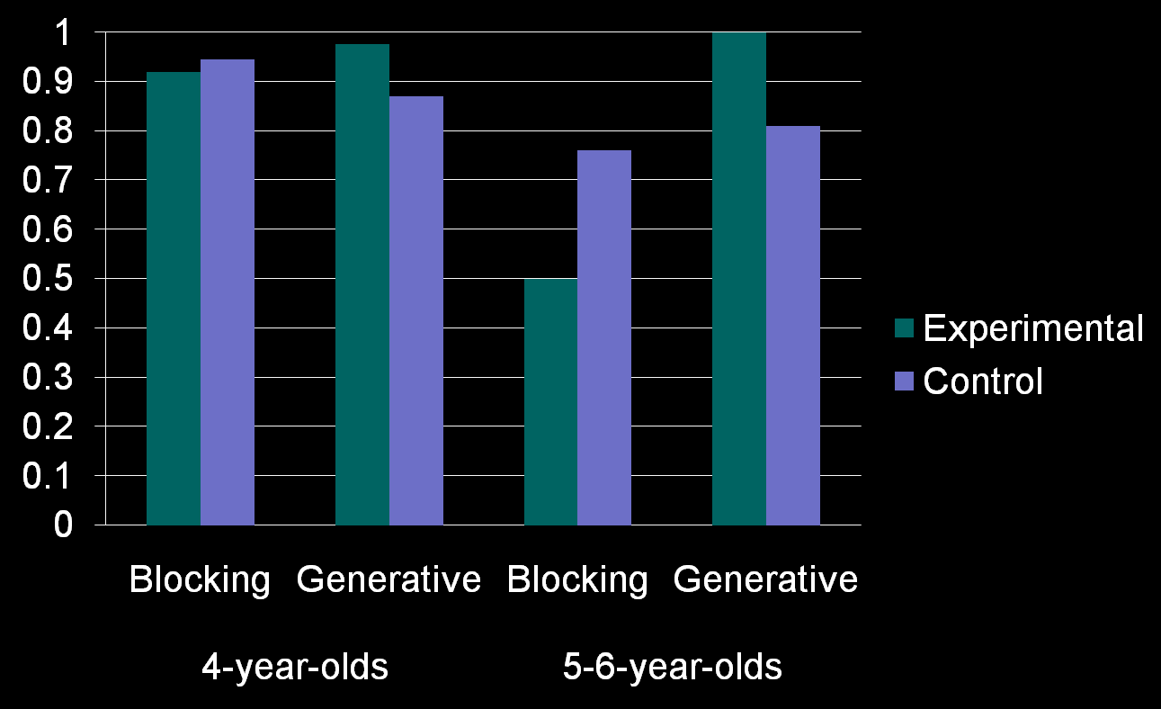
Backwards results
Notes:
Only 5-6-year-olds show significant differences here either between blocking/control or in fact between RG and BB.

Slide 19
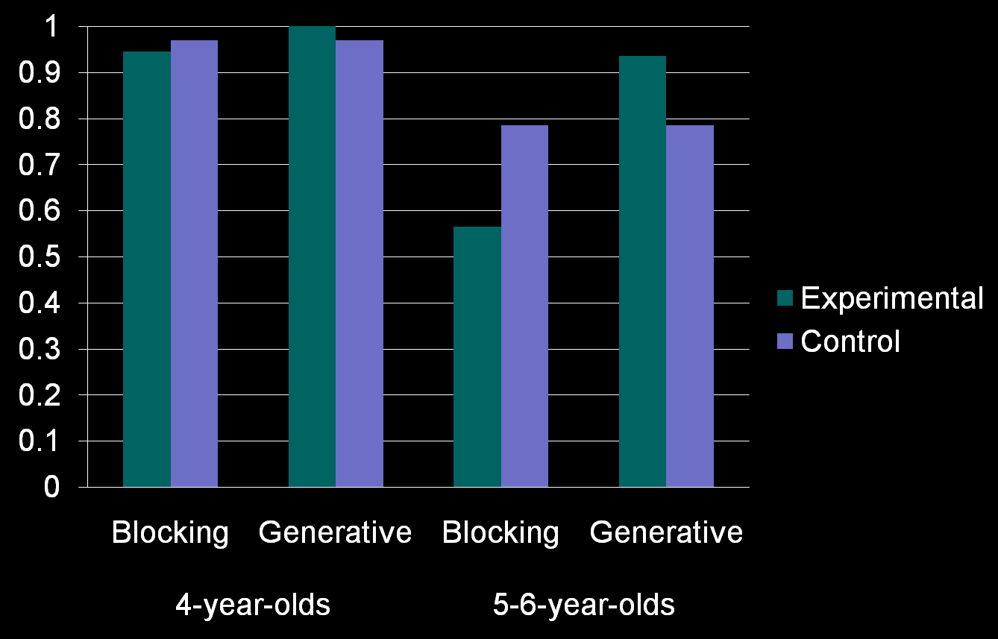
Forwards results
Notes:
Forwards results identical.

Slide 20
Summary of Causal Findings
No effects of order of demonstrations (backwards = forwards).
Difference between trial types only in 5-6-year-old group.
Why the developmental change?
Notes:
In this modified version of the task, we find evidence for BB only in older group. Suggests potentially not true blocking in first experiment. So now we have a developmental change to explain.

Slide 21
Processing account
(1) A sets off the detector on its own.
(2) A and B set off the detector together.
(3) But the detector would have gone off anyway if B had not been there.
(4) Therefore, previous demonstrations provide us with no useful information about B’s causal status.
Only children capable of making counterfactual judgment in (3) should show pattern suggestive of (4)
Notes:
Let’s remind ourselves of the account of blocking that draws upon counterfactual reasoning. It may be that in fact the younger children aren’t capable of making the appropriate counterfactual judgment? That may explain their lack of blocking. If we could show that only the older children can make (3) then we might achieve two things: some support for a counterfactual analysis of the process underpinning blocking and also an explanation of our developmental change found in last experiment.

Slide 22
Psychological Relatedness Account?
Would detector have gone off without A/B?
Judgments about detector’s state without either A or B should be consistent with pattern of their causal judgments
Notes:
Even if we don’t want to push such a line, we nevertheless might be interested in whether children’s counterfactual judgments are consistent with their causal ones.

Slide 23
Counterfactual Experiment 1
“But the detector would have gone off anyway if B had not been there.”
Trials identical to backwards condition in previous causal experiment.
“Is A a blicket?”
“A moment ago I put both of these blocks on the machine and it went off. Do you think it would have gone off if I hadn’t put this (color of B) block on?”
Notes:
In this first experiment on counterfactual reasoning, we examined whether children were able to make the counterfactual judgment that formed part of the chain of reasoning that may underpin blocking.
First asked whether or not A is a blicket; then asked the counterfactual question.

Slide 24
Backwards Condition
Demo | 1 | 2 | 3 | Without B?
Trial Type
Backwards blocking | AB√ | AB√ | A√ | Yes
Control | BC√ | BC√ | A√ | ?
Retrospective generative | AB√ | AB√ | Ax | No
Control | BC√ | BC√ | Ax | ?
Notes:
A reminder of the different trial types. There is a correct answer for the two experimental trials; for the two control trials gives a measure of how likely they are to say “yes” to the counterfactual question when they haven’t seen one of the items on its own.

Slide 25

Previous Experiment: Is A a Blicket?
Notes:
Now, in the previous causal experiment, judgments regarding whether or not A is a blicket are at ceiling in the experimental trials; for the control trials we have included their judgments for the B item, which is what they are asked about in the counterfactual question in this experiment.

Slide 26
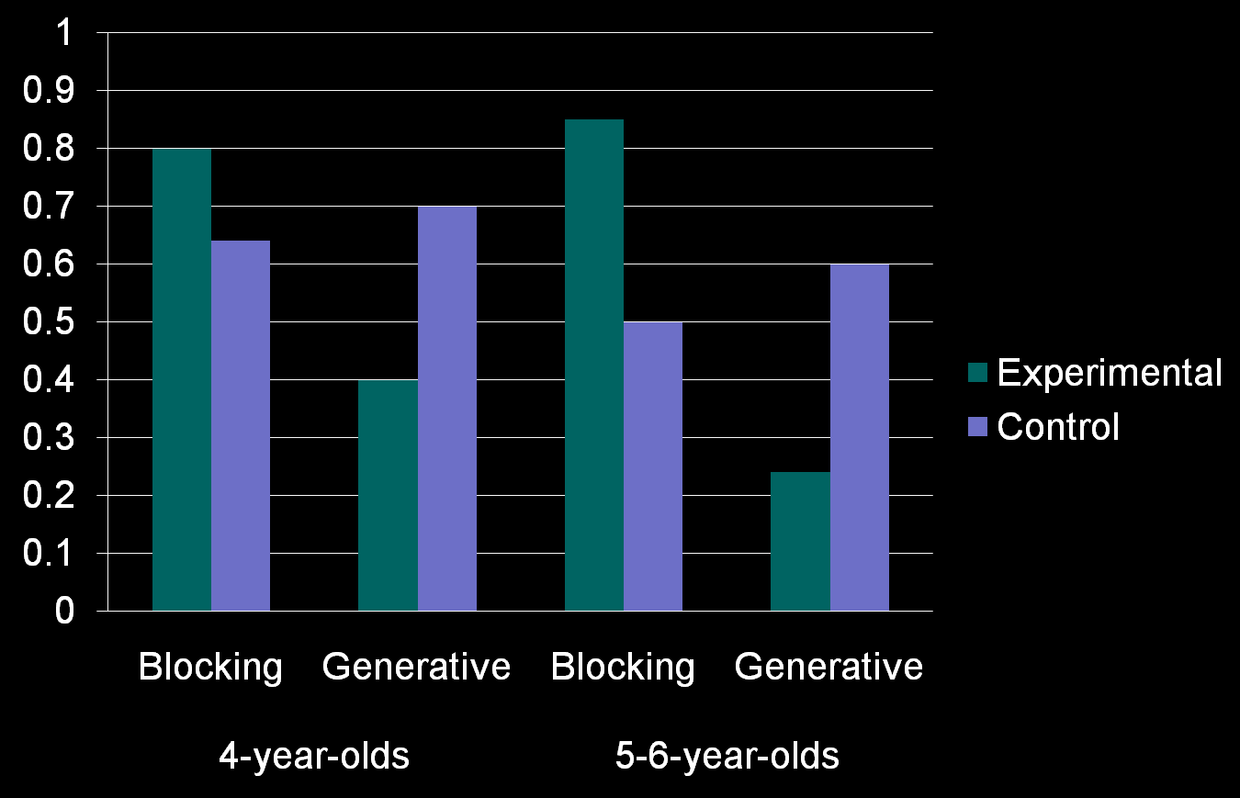
Would the machine gone off without B?
Notes:
We are predicting this graph to look similar to the previous one. In fact, although levels of performance are not as good, the same pattern is found. Children are making some errors – e.g., in blocking trials they have just seen A set the detector off, but about 20% of the time they judge that the machine would not have gone off if B had not been present; similarly, they are judging the detector would have gone off about 40% of time in generative trials even though they have just seen that it doesn’t go off when A is on on its own. Nevertheless, the pattern is non-random in both groups. Significant differences between blocking/generative and between each experimental trial type and its control.

Slide 27
Summary of findings
Children nowhere near as accurate at making counterfactual judgments as causal ones.
However, both age-groups were not performing randomly: differences between blocking and generative trials AND between relevant control trials and experimental trials.
As a group, even 4-year-olds can make appropriate counterfactual judgments.
No age differences

Slide 28
Where does this leave us?
Counterfactual analysis of processes might be correct, but counterfactual component may be necessary but not sufficient.
Not immediately obvious can serve as account of previously-found developmental change.
What about consistency?
Notes:
Findings would suggest that even 4-year-olds, who don’t show blocking, can make the relevant counterfactual judgement. If we want to explain developmental change found in causal experiment, we would have to say it may be necessary but not sufficient – need to draw on some additional factor that accounts for developmental change (return to this at end of talk). In any case, we have some initial evidence of broad consistency between counterfactual and causal judgements, in that pattern of counterfactual judgments to A is similar to pattern of causal judgments – what about judgments regarding the potentially blocked item B?

Slide 29
Counterfactual Experiment 2
Trials identical to previous causal experiment.
“Is A a blicket?”
“A moment ago I put both of these blocks on the detector and it went off. Do you think it still would have gone off if I hadn’t put this (color of A) block on?”

Slide 30
Backwards Condition
Demo | 1 | 2 | 3 | Without A
Trial Type
Backwards blocking | AB√ | AB√ | A√ | No
Control | BC√ | BC√ | A√ | 66%
Retrospective generative | AB√ | AB√ | Ax | Yes
Control | BC√ | BC√ | Ax | 66%

Slide 31
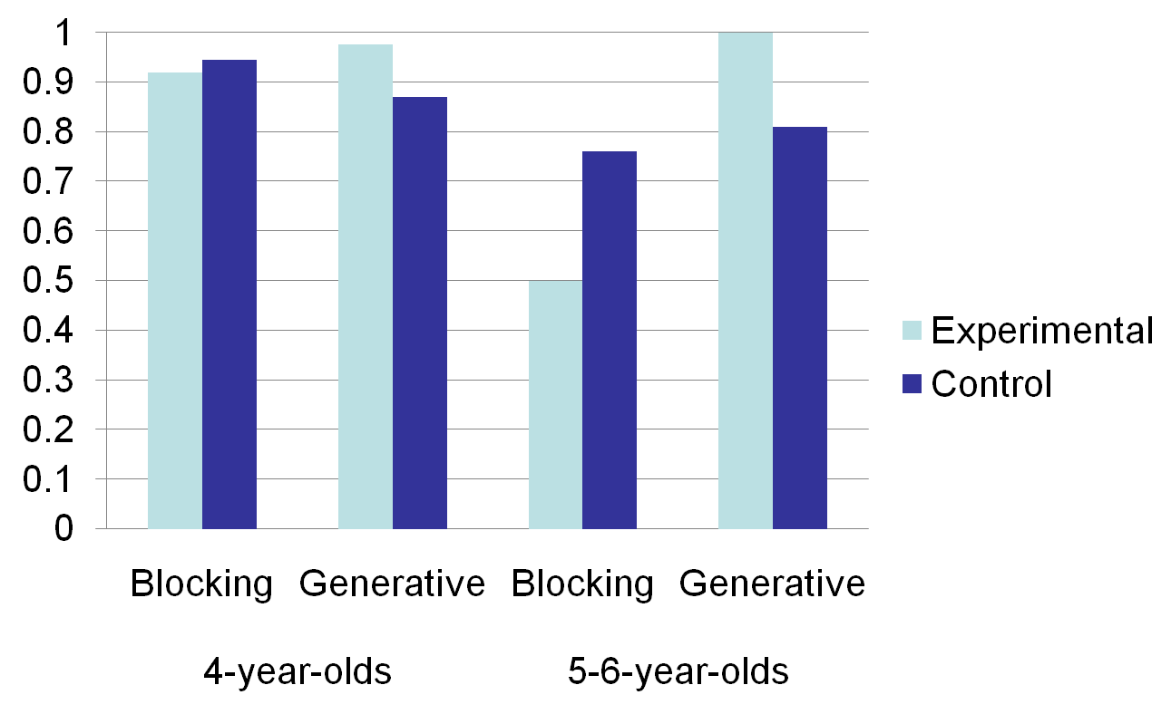
Backwards results
Notes:
A reminder of the causal results from previous experiment. Only 5-6-year-olds show significant differences here either between blocking/control or in fact between RG and BB.

Slide 32
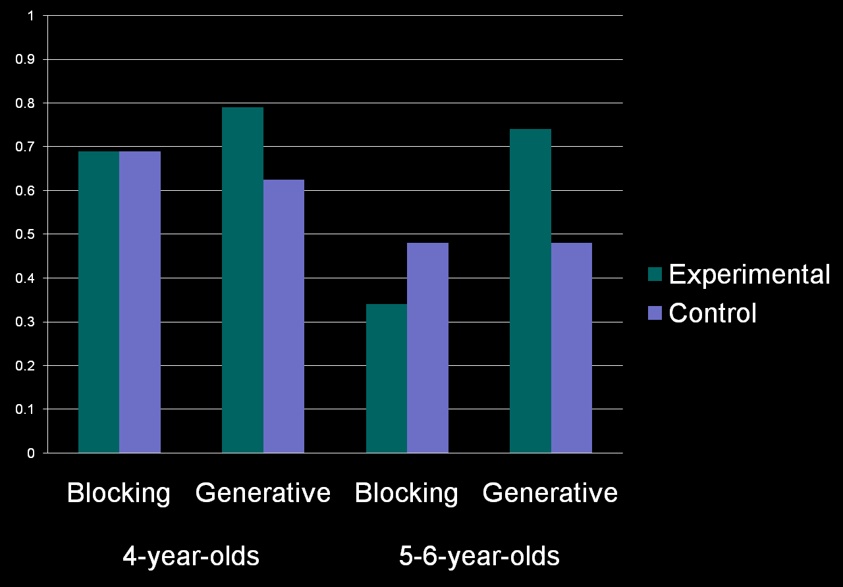
Would the detector have gone off without A?
Notes:
Pattern of results very similar. No difference between BB and its control for the 4-year-olds, nor in fact between RG and BB for this group, although RG does differ from its control, whereas the 5-6-year-olds show appropriate differences. Just mention: BB and its control just misses significance.

Slide 33
Summary of findings
Only older group showing appropriate differences between trial types.
No evidence of blocking in 4-year-olds, or difference between retrospective/generative trials.
Findings consistent with causal findings.

Slide 34
Counterfactual Experiment 3
Perhaps need to make it explicit that question translates to “Would the machine have gone off if B had been placed on it on its own?”
“A moment ago I put both of these blocks on the machine and it went off. Do you think it would have gone off if I had put this one (B) on on its own?
Notes:
Evidence from last counterfactual experiment consistent with that from causal and suggests BB only in older group. However, it may be that we need to make the counterfactual question more straightforward – asked would it have gone off if A had not been there – perhaps more difficult as requires in a sense mentally undoing the placing of A along with B – what if we ask about what would have happened if B on its own?

Slide 35
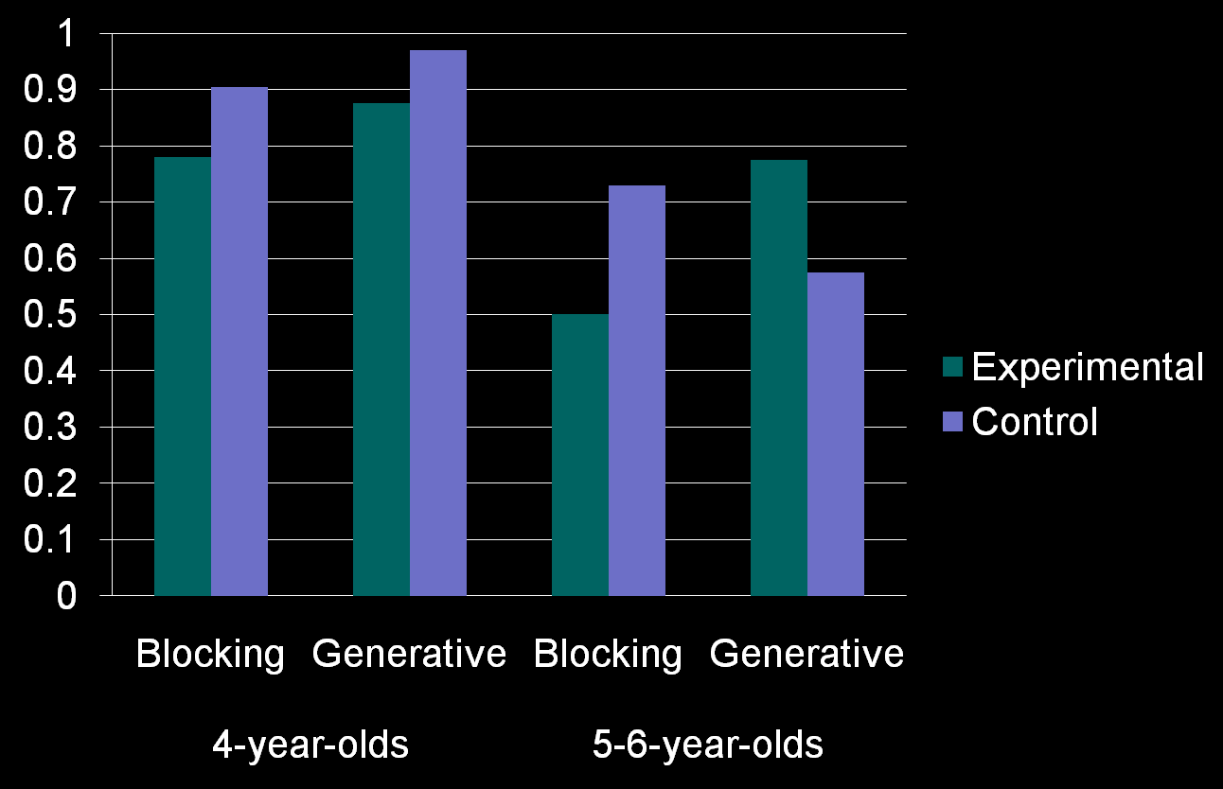
B on its own?
Notes:
Similar pattern of effects, age differences.

Slide 36
Summary of findings
Again, only older group show appropriate differences between trial types.
No evidence of blocking, or of differentiating between generative and blocking trials, in 4-year-olds.
Consistent with causal findings.

Slide 37
Where does this leave us?
Good evidence for a psychological relatedness account: consistency between causal and counterfactual judgements in both age groups.
Not clear we can use these data as positive evidence for a processing account in this experiment.
However, processing account may still be correct.
But what is changing developmentally?

Slide 38
Possible explanations of developmental change
Most boring explanation: 4-year-olds say “yes” to everything.
4-year-olds default to using a heuristic incompatible with blocking.
Difficulty spontaneously using counterfactual reasoning?
Difficulty tracking/comparing probabilities?
Notes:
Note that this can’t be quite true, because they are at ceiling in saying no to A items that they have seen don’t set off the detector. In fact, their performance may be a result of a simple heuristic: say yes to everything unless you have seen that it doesn’t set off the detector. Note that this won’t result in blocking. However, we can still ask “why does this age-group default to use of such a heuristic?”. Is it because they don’t realise the importance of considering the counterfactual alternative? Is it because they aren’t sensitive to either baseline rate of blickets (but evidence from David’s work would suggest they are sensitive to that) or the probability of B being a blicket in the paired control trials?

